Slide 1


Emilio Aguilera
20/01/2023

Slide 2

Outline
Executive Summary
Introduction
Methodology
Results
Conclusion
Appendix

Slide 3
Executive Summary
Summary of methodologies
Data Collection using web scraping and SpaceX API
Exploratory Data Analysis, including data wrangling, data visualization and interactive visual analytics
Machine Learning Prediction
Summary of all results
It was possible to collect valuable data from public sources
EDA allowed to identify which features are the best to predict success of launchings
Machine Learning Prediction showed the best model to predict which characteristics are important to drive this opportunity by the best way, using all collected data.

Slide 4
Introduction
The objective is to evaluate the viability of the new company Space Y to compete with Space X
Questions to be answered
How do variables such a payload mass, launch site, number of flights and orbits affect the success of the first stage landing?
Does the rate of successful landings increase over the years?
Which is the best algorithm that can be used for binary classification?

Slide 5

Section 1

Slide 6
Methodology
Executive Summary
Data collection methodology:
Using SpaceX Rest API
Using Web Scrapping from Wikipedia
Perform data wrangling
Filtering the data
Dealing with missing values
Using One Hot Encoding to prepare the data to a binary classification
Perform exploratory data analysis (EDA) using visualization and SQL
Perform interactive visual analytics using Folium and Plotly Dash
Perform predictive analysis using classification models
Building, tuning and evaluation of classification models to ensure the best result

Slide 7
Data Collection
Data sets were collected from SpaceX API and from Wikipedia using web scraping technics.

Slide 8
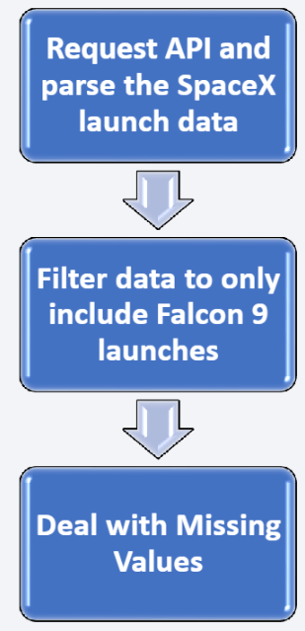
Data Collection – SpaceX API
Spacex offers a public API from where data can be obtained and the used
This API was used according to the flowchart beside and the data is persisted
GitHub URL: https://github.com/Farandulas/testrepo/blob/master/Final_Assignment.ipynb

Slide 9
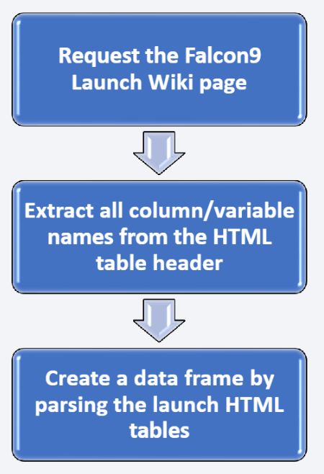
Data Collection - Scraping
Data from SpaceX launches can also be obtained from Wikipedia with web scraping
GitHub URL: https://github.com/Farandulas/testrepo/blob/master/Data%20Collection%20with%20Web%20Scraping.ipynb

Slide 10
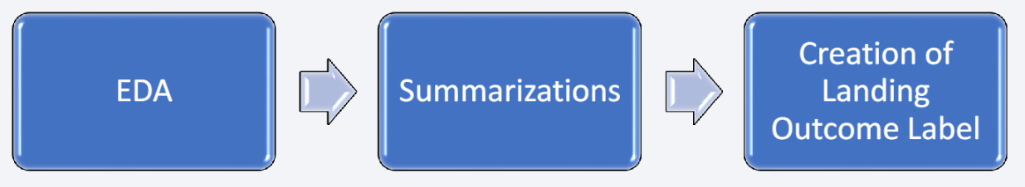
Data Wrangling
Initially some Exploratory Data Analysis (EDA) was performed on the dataset
The the summaries launches per site, occurrences of each orbit and occurrences of mission outcome per orbit type were calculated.
Finally the landing outcome label was created from Outcome column.
GitHub URL: https://github.com/Farandulas/testrepo/blob/master/Data%20Wrangling.ipynb

Slide 11
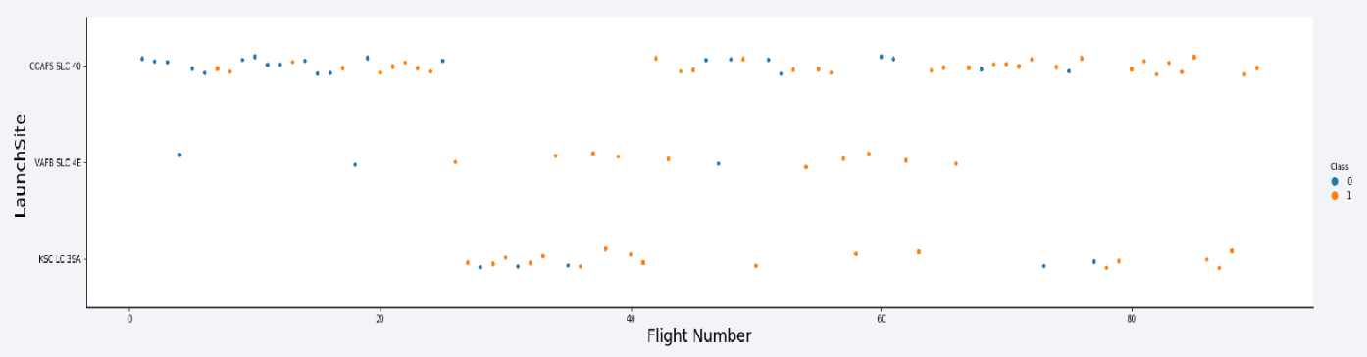
EDA with Data Visualization
To explore data, scatterplots and bar plots were used to visualizate the relationship between pair of features:
Payload Mass X Flight Number, Launch Site X Flight Number, Launch Site X Payload Mass, Orbit and Flight Number, Payload and Orbit
GitHub URL: https://github.com/Farandulas/testrepo/blob/master/EDA%20with%20Visualization.ipynb

Slide 12
EDA with SQL
The following SQL queries were performed:
Names of the unique launch sites in the space mission;
Top 5 launch sites whose name begin with the string 'CA';
Total payload mass carried by boosters launched by NASA (CRS);
Average payload mass carried by booster version F9 v1.1;
Date when the first successful landing outcome in ground pad was achieved;
Names of the boosters which have success in drone ship and have payload mass between4000 and 6000 kg;
Total number of successful and failure mission outcomes;
Names of the booster versions which have carried the maximum payload mass;
Failed landing outcomes in drone ship, their booster versions, and launch site names for in year 2015; and
Rank of the count of landing outcomes (such as Failure (drone ship) or Success (ground pad))
GitHub URL: https://github.com/Farandulas/testrepo/blob/master/EDA%20with%20SQL.ipynb

Slide 13
Build an Interactive Map with Folium
Markers, circles, lines and marker clusters were used with Folium Maps
Markers indicate points like launch sites;
Circles indicate highlighted areas around specific coordinates, like NASA Johnson SpaceCenter;
Marker clusters indicates groups of events in each coordinate, like launches in a launch site;
Lines are used to indicate distances between two coordinates.
GitHub URL: https://github.com/Farandulas/testrepo/blob/master/Interactive%20Visual%20Analytics%20with%20Folium.ipynb

Slide 14
Build a Dashboard with Plotly Dash
The following graphs and plots were used to visualize data
Percentage of launches by site
Payload range•
This combination allowed to quickly analyze the relation between payloads and launch sites, helping to identify where is best place to launch according to payloads.

Slide 15
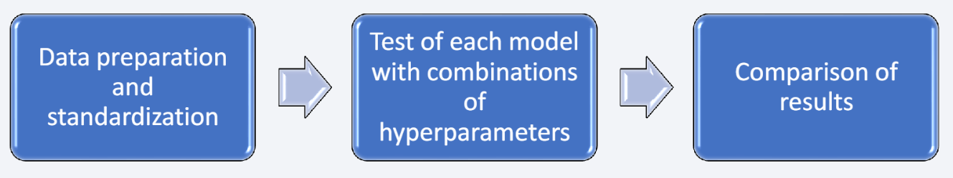
Predictive Analysis (Classification)
Four classification models were compared: logic regression, support vector machine, decision tree and k-nearest neighbors
GitHub URL: https://github.com/Farandulas/testrepo/blob/master/Machine%20Learning%20Prediction.ipynb

Slide 16
Results
Exploratory data analysis results:
Space X uses 4 different launch sites;
The first launches were done to Space X itself and NASA;
The average payload of F9 v1.1 booster is 2,928 kg;
The first success landing outcome happened in 2015 fiver year after the first launch;
Many Falcon 9 booster versions were successful at landing in drone ships having payload above the average;
Almost 100% of mission outcomes were successful;
Two booster versions failed at landing in drone ships in 2015: F9 v1.1 B1012 and F9 v1.1 B1015;
The number of landing outcomes became as better as years passed.

Slide 17
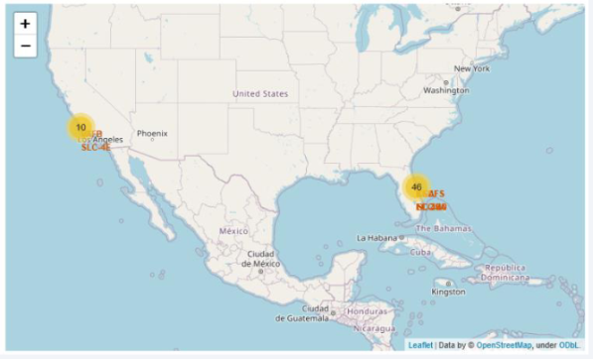
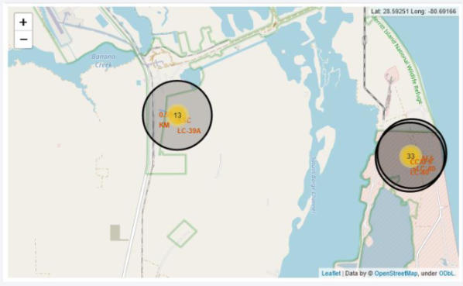
Results
Using interactive analytics was possible to identify that launch sites use to be in safety places, near sea, for example and have a good logistic infrastructure around.
Most launches happens at east cost launch sites

Slide 18
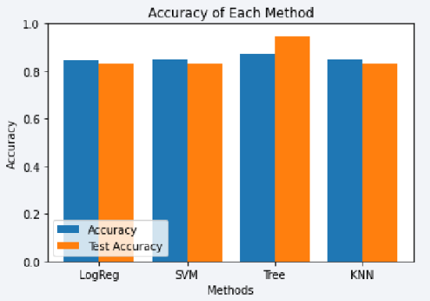
Results
Predictive Analysis showed that Decision Tree Classifier is the best model to predict successful landings, having accuracy over 87% and accuracy for test data over 94%.

Slide 19

Section 2

Slide 20
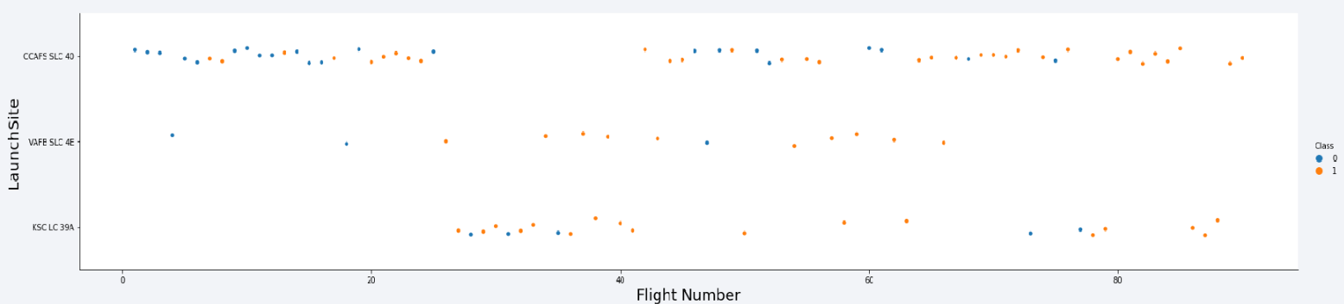
Flight Number vs. Launch Site
• According to the plot above, it’s possible to verify that the best launch site nowadays is CCAF5 SLC 40, where most of recent launches were successful;
• In second place VAFB SLC 4E and third place KSC LC 39A;
• It’s also possible to see that the general success rate improved over time.

Slide 21
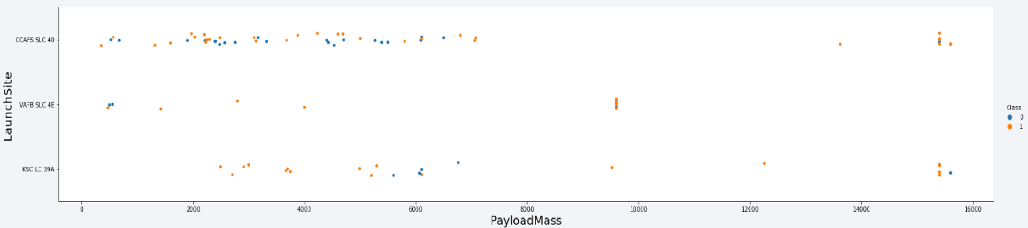
Payload vs. Launch Site
Payloads over 9,000kg (about the weight of a school bus) have excellent success rate;
Payloads over 12,000kg seems to be possible only on CCAFS SLC 40 and KSC LC 39A launch sites.

Slide 22
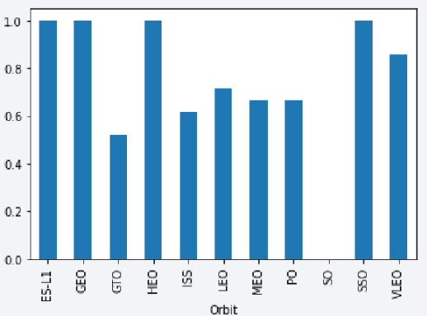
Success Rate vs. Orbit Type
• The biggest success rates happens to orbits:
• ES-L1;
• GEO;
• HEO; and
• SSO.
• Followed by:
• VLEO (above 80%); and
• LFO (above 70%).

Slide 23
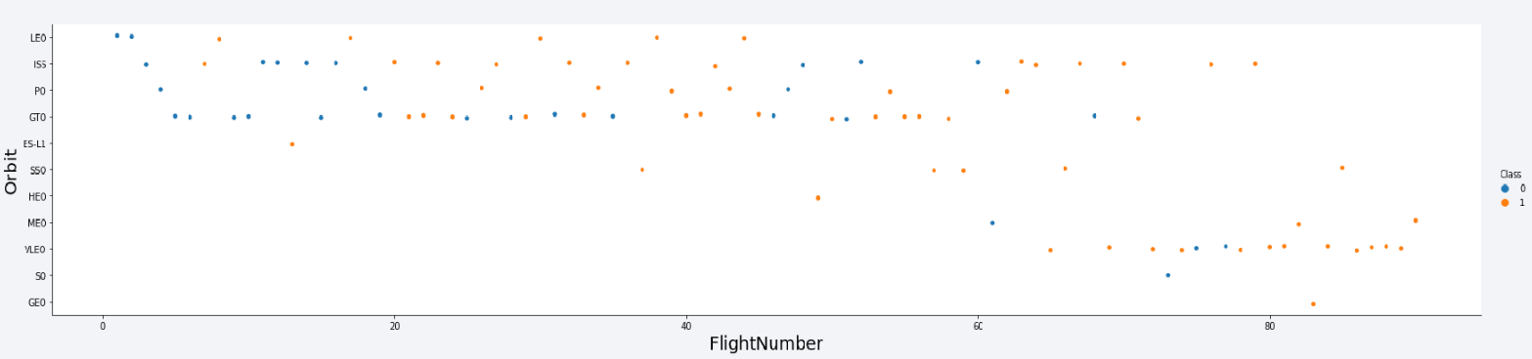
Flight Number vs. Orbit Type
• Apparently, success rate improved over time to all orbits;
• VLEO orbit seems a new business opportunity, due to recent increase of its frequency.

Slide 24
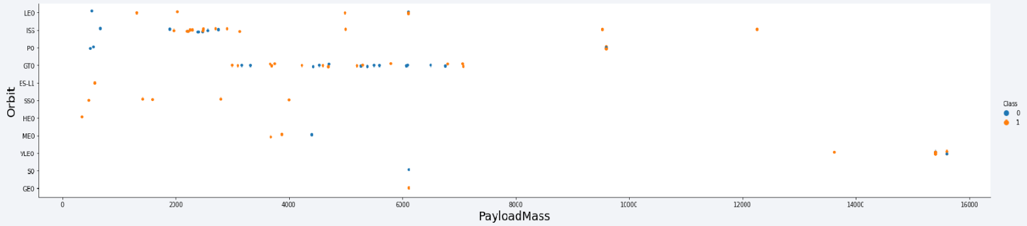
Payload vs. Orbit Type
• Apparently, there is no relation between payload and success rate to orbit GTO;
• ISS orbit has the widest range of payload and a good rate of success;
• There are few launches to the orbits SO and GEO.

Slide 25
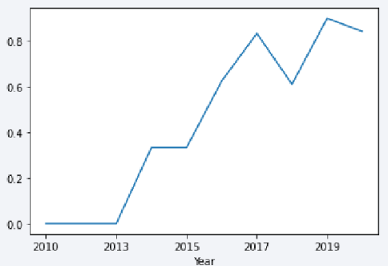
Launch Success Yearly Trend
• Success rate started increasing in 2013 and kept until 2020;
• It seems that the first three years were a period of adjusts and improvement of technology.

Slide 26
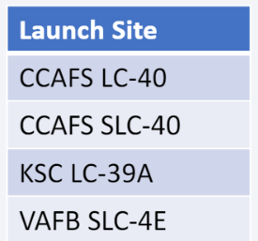
All Launch Site Names
According to data, there are four launch sites:
They are obtained by selecting unique occurrences of “launch_site” values from the dataset.

Slide 27
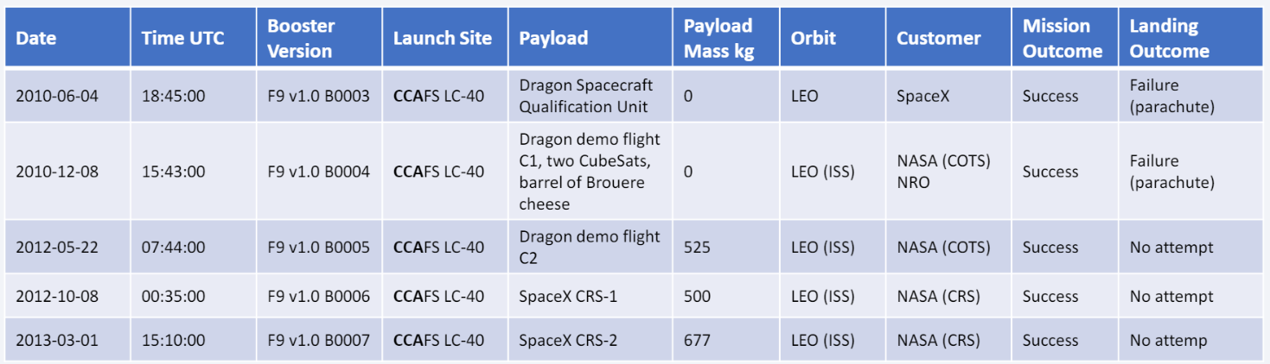
Launch Site Names Begin with 'CCA'
5 records where launch sites begin with `CCA`:
Here we can see five samples of Cape Canaveral launches.

Slide 28
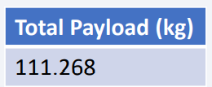
Total Payload Mass
Total payload carried by boosters from NASA:
Total payload calculated above, by summing all payloads whose codes contain ‘CRS’, which corresponds to NASA.

Slide 29
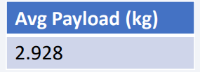
Average Payload Mass by F9 v1.1
Average payload mass carried by booster version F9 v1.1:
Filtering data by the booster version above and calculating the average payload mass we obtained the value of 2,928 kg.

Slide 30
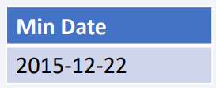
First Successful Ground Landing Date
First successful landing outcome on ground pad:
By filtering data by successful landing outcome on ground pad and getting the minimum value for date it’s possible to identify the first occurrence, that happened on 12/22/2015.

Slide 31
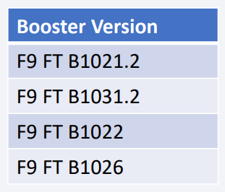
Successful Drone Ship Landing with Payload between 4000 and 6000
Boosters which have successfully landed on drone ship and had payload mass greater than 4000 but less than 6000
Selecting distinct booster versions according to the filters above, these 4 are the result.

Slide 32
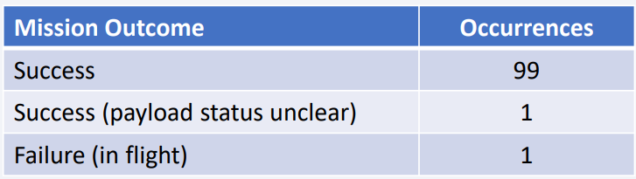
Total Number of Successful and Failure Mission Outcomes
Number of successful and failure mission outcomes:
Grouping mission outcomes and counting records for each group led us to the summary above.

Slide 33
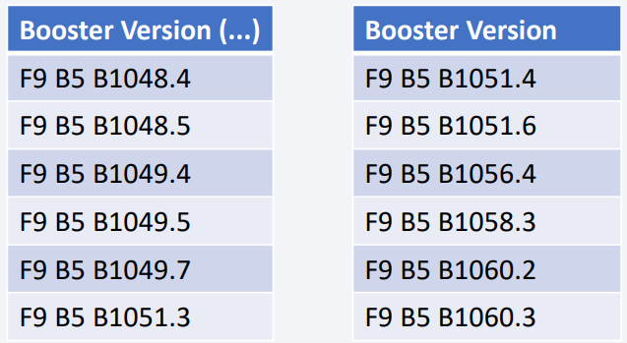
Boosters Carried Maximum Payload
Boosters which have carried the maximum payload mass
These are the boosters which have carried the maximum payload mass registered in the dataset.

Slide 34
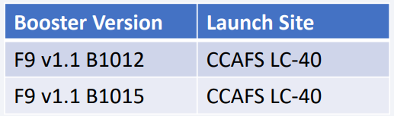
2015 Launch Records
Failed landing outcomes in drone ship, their booster versions, and launch site names for in year 2015
The list above has the only two occurrences

Slide 35
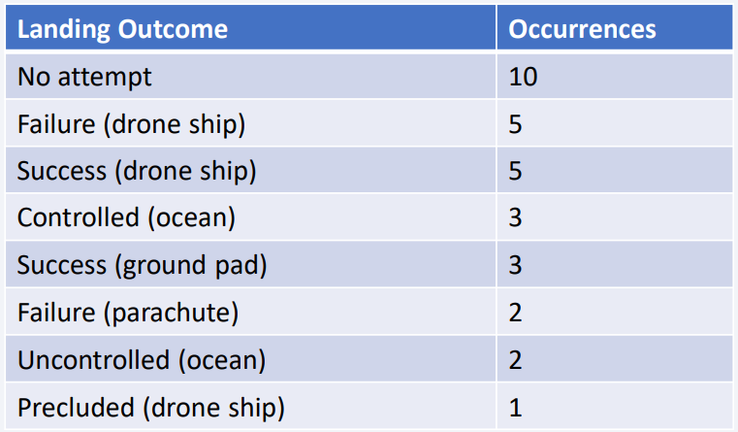
Rank Landing Outcomes Between 2010-06-04 and 2017-03-20
Ranking of all landing outcomes between the date 2010-06-04 and 2017- 03-20:
This view of data alerts us that “No attempt” must be taken in account

Slide 36

Section 3

Slide 37
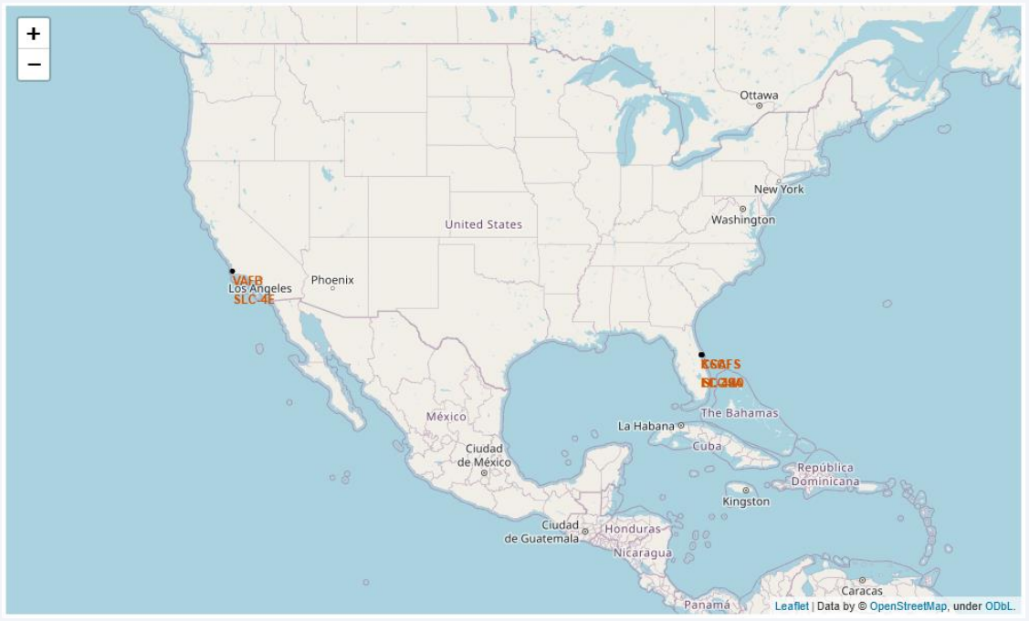
All launch sites
Launch sites are near sea, probably by safety, but not too far from roads and railroads.

Slide 38
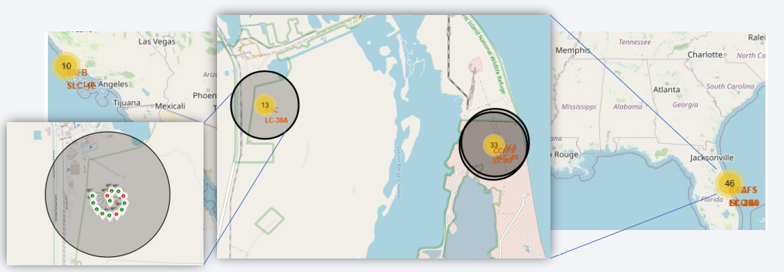
Launch Outcomes by Site
Example of KSC LC-39A launch site launch outcomes
Green markers indicate successful and red ones indicate failure.

Slide 39
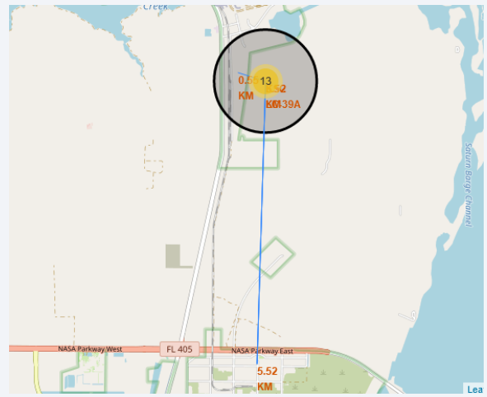
Logistics and Safety
Launch site KSC LC-39A has good logistics aspects, being near railroad and road and relatively far from inhabited areas.

Slide 40

Section 4

Slide 41
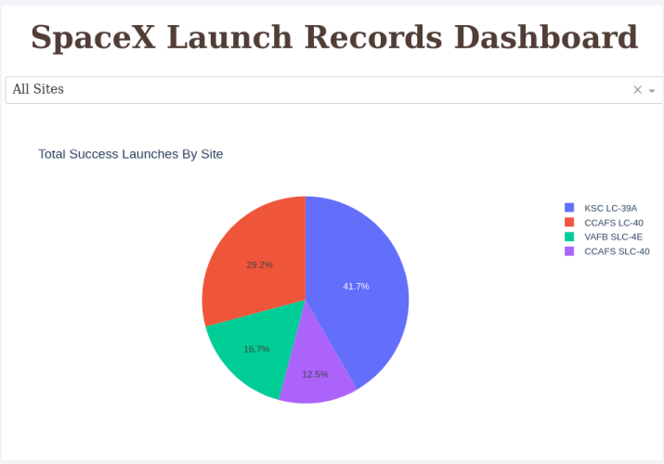
Successful Launches by Site
The place from where launches are done seems to be a very important factor of success of missions.

Slide 42
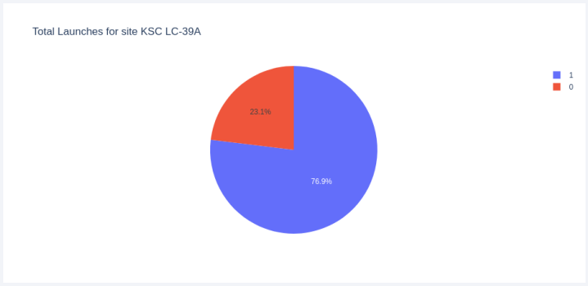
Launch Success Ratio for KSC LC-39A
76.9% of launches are successful in this site.

Slide 43
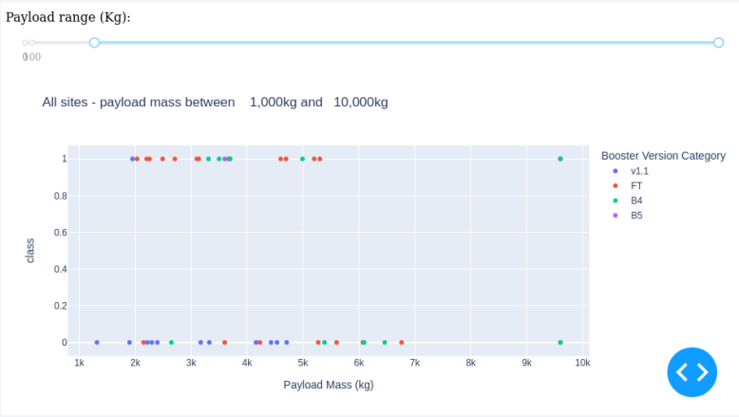
Payload vs. Launch Outcome
Payloads under 6,000kg and FT boosters are the most successful combination.

Slide 44
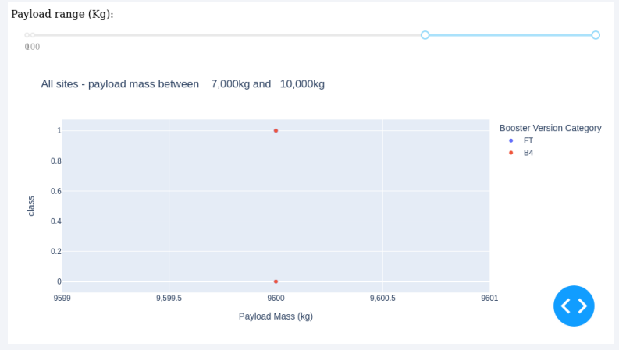
Payload vs. Launch Outcome
There’s not enough data to estimate risk of launches over 7,000kg

Slide 45

Section 5

Slide 46
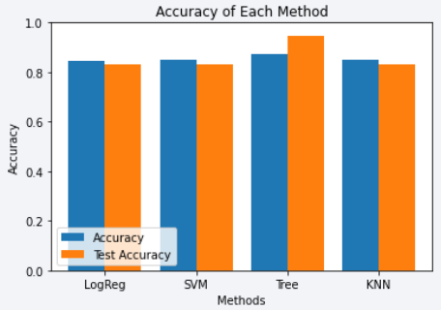
Classification Accuracy
Four classification models were tested, and their accuracies are plotted beside;
The model with the highest classification accuracy is Decision Tree Classifier, which has accuracies over than 87%.

Slide 47
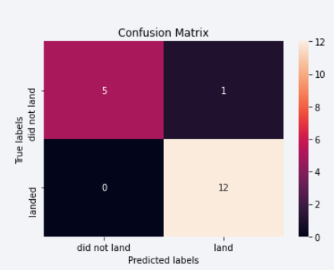
Confusion Matrix
Confusion matrix of Decision Tree Classifier proves its accuracy by showing the big numbers of true positive and true negative compared to the false ones.

Slide 48
Conclusions
• Different data sources were analyzed, refining conclusions along the process; • The best launch site is KSC LC-39A;
• Launches above 7,000kg are less risky;
• Although most of mission outcomes are successful, successful landing outcomes seem to improve over time, according the evolution of processes and rockets;
• Decision Tree Classifier can be used to predict successful landings and increase profits.

Slide 49
Appendix
As an improvement for model tests, it’s important to set a value to np.random.seed variable.

Slide 50


